Slide 1
Indian knowledge system
Nataraja – a masterpiece of indian art

Slide 2
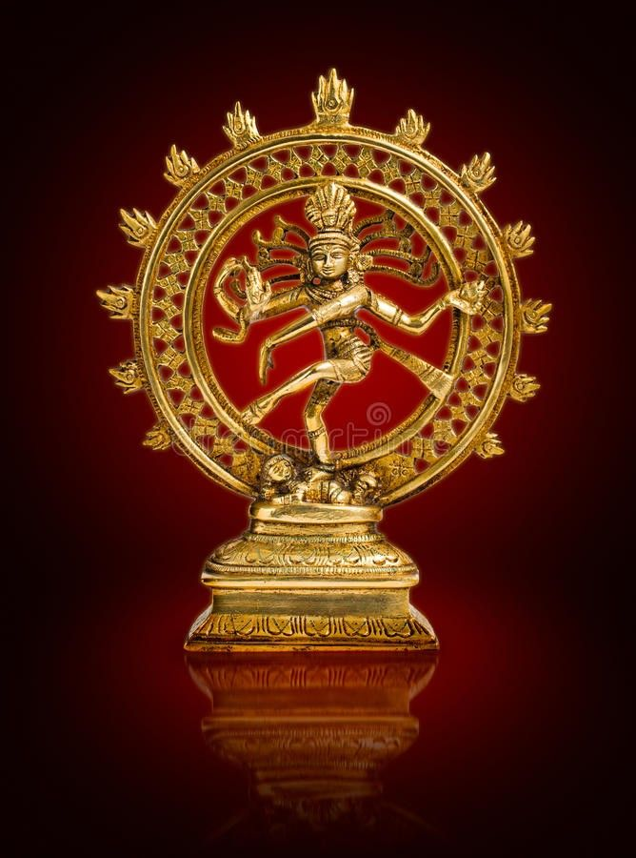
nataraja

Slide 3
introduction
Nataraja is the name given to the form the Hindu god Shiva embodies as the cosmic dancer and is often represented in sculpture. Nataraja means "the Lord of the Dance" in Sanskrit (from nata meaning "dance, performance," and raja meaning "lord").

Slide 4
introduction
The Nataraja statue represents the Hindu god Shiva as the cosmic dancer, a form particularly revered in South Indian Shaivite temples. In this depiction, Shiva is shown with four arms, dancing on a dwarf symbolizing human ignorance. His back right hand holds a damaru (drum), the front right hand is in the abhaya mudra (fear-not gesture), the back left hand carries fire, and the front left hand points to his uplifted left foot. Encircled by a ring of flames, the statue symbolizes Shiva's role in the cosmic cycle of creation, protection, destruction, embodiment, and release. This dance, known as the tandava, is associated with the dissolution of the universe at the end of an eon and is believed to have been performed in Chidambaram, a significant Shaiva center in South India.

Slide 5
The cultural significance of the Nataraja statue in Hinduism is profound. It symbolizes Shiva's role in the cosmic cycle, representing his five activities: creation, protection, destruction, embodiment, and release. The dance, performed in Chidambaram, is believed to be at the universe's center and the human heart, highlighting the interconnectedness of the cosmos and individual spirituality. This form of Shiva is not only a religious symbol but also an artistic representation of divine rhythm and cosmic balance, illustrating the integration of art, spirituality, and philosophy in Hindu culture.

Slide 6
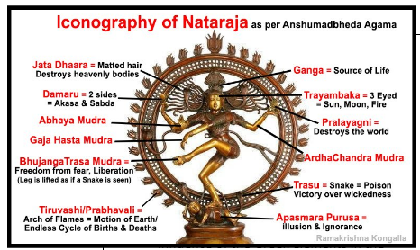

Slide 7
Emergence of Nataraja Form
The concept of Shiva as a dancer, known as Nataraja, began to take shape around the 5th century AD.
Early depictions of Shiva's dance laid the foundation for the multifaceted symbolism associated with the Nataraja form.
Shiva Under the Cholas:
During the reign of the Chola dynasty (9th-11th centuries AD), Shiva's Nataraja form underwent significant development.
The Cholas, known for their patronage of art and culture, played a pivotal role in shaping Nataraja's cultural significance.
The Cholas were devout Shaivites, emphasizing the worship of Lord Shiva.
They constructed grand Shiva temples throughout their territories, with the Brihadeeswara Temple in Thanjavur being a prominent example. with a particular focus on Shaiva figures in their sculptures.

Slide 8
Evolution of Nataraja Iconography
Nataraja's symbolism grew more complex under the Cholas.
Lord Shiva is a complex deity in the Puranic pantheon, embodying both destructive and ascetic qualities.
Nataraja, the 'Lord of Dance,' is celebrated for his invention of 108 diverse dances. The dancing Shiva became associated with both creation and destruction, embodying the dualities of life.
The dance was seen as a cosmic dance, with Shiva as the cosmic dancer, and the world as the stage.
Iconic Elements of Nataraja
In iconic representations, Nataraja is depicted within a flaming aureole or halo, symbolizing the circle of the world.
His long, flowing dreadlocks signify the energy and dynamism of his dance.
Nataraja is typically shown with four arms, each holding symbolic objects that convey deeper meanings.

Slide 9
Symbolism in Nataraja's Attributes
Nataraja holds a damru (hand drum) in his upper right hand, which draws all creatures into his rhythmic motion, and in his upper left arm, he wields Agni (fire), symbolizing his power to destroy the universe.
Beneath one of Nataraja's feet lies a crushed dwarf-like figure, representing illusion and worldly distractions.
In ornamentation, one ear of Shiva has a male earring while the other has a female.
This represents the fusion of male and female and is often referred to as Ardhanarishwar.
A snake is twisted around the arm of Shiva. The snake symbolises the kundalini power, which resides in the human spine in the dormant stage. If aroused, one can attain true consciousness.

Slide 10
Nataraja as Protector and Reassurer
Despite the formidable symbolism associated with Nataraja, he also serves as a protector.
The 'abhayamudra' (fear-allaying gesture) made with his front right hand reassures devotees, offering protection from fear and doubt.
Nataraja's raised feet and his gesture with his front left-hand point to his feet, inviting devotees to seek refuge in him.

Slide 11
Nataraja's Smile
One of the distinctive features of Nataraja's iconography is his almost always present broad smile.
The French historian Renee Grousset beautifully described Nataraja's smile as representing both "death and life, both joy and pain."

Slide 12
Lost Wax Method
Sculptors who created the Nataraja statue which is placed at the Bharat Mandapam, New Delhi, trace their lineage 34 generations back to the Cholas.
The crafting process used is the traditional 'lost-wax' casting method, indigenous to the Chola era.
The lost-wax method dates back at least 6,000 years, a copper amulet crafted using this method at a neolithic site in Mehrgarh, Balochistan (present day Pakistan) is dated to circa 4,000 BC.
Notably, the Dancing Girl of Mohenjo Daro was also crafted using this technique.
This method involves creating a detailed wax model, coating it with alluvial soil, heating to burn away the wax, and filling the mold with molten metal.
The Cholas excelled in the lost wax method for producing elaborate metallic sculptures.
This technique was used to create intricate sculptures for millennia.

Slide 13
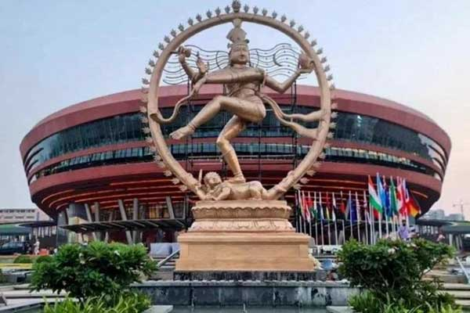
Nataraja Sculpture at G20 Summit

